Slide 1
Interviewing

Slide 2
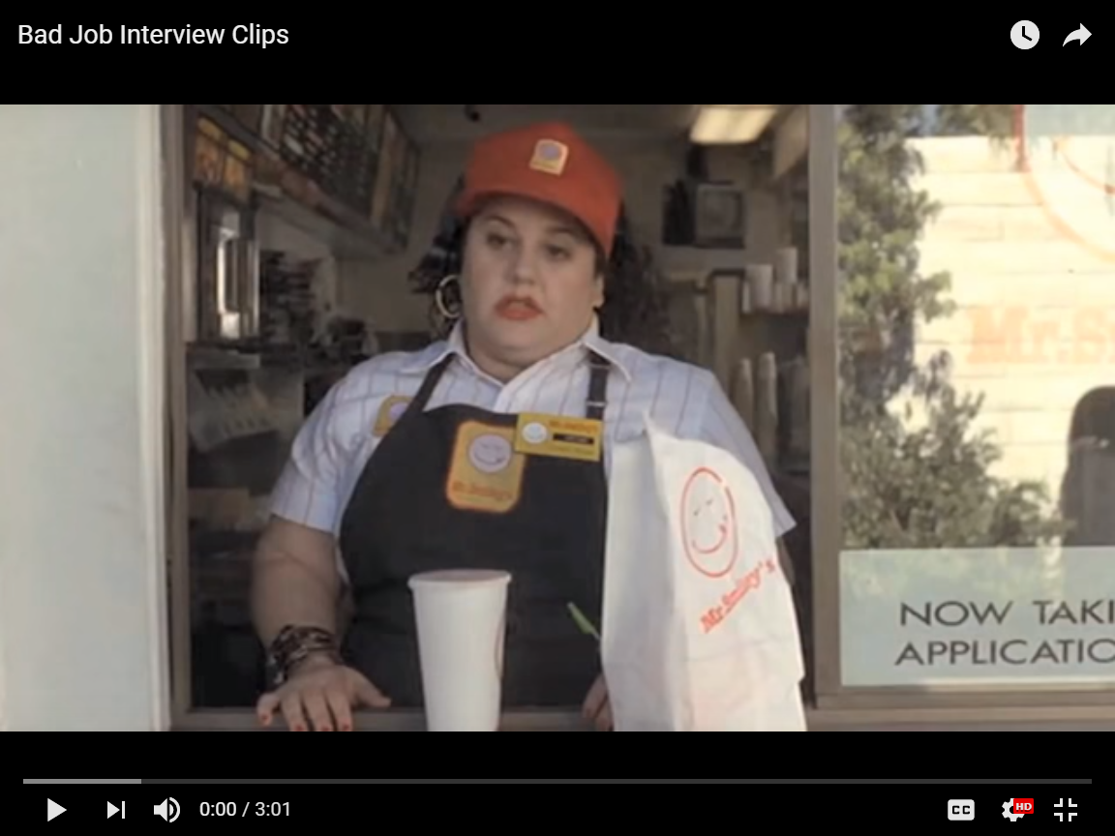
Interviews . . . What NOT to do

Slide 3
Making that 1st Impression
Only get one shot!!
“Elevator Pitch”
30 seconds (4-5 sentences), Self-introduction
Describes past experiences, positive qualities, & career goals
https://www.youtube.com/watch?v=IxunO4S96F4

Slide 4
Ways to Make a Good 1st Impression
Arrive on time
Dress appropriately
As if you have the job (or better than . . . Mechanic)
Conservative clothing . . . NO baggy jeans, low tops, short skirts
NO loud jewelry or powerful perfume/cologne
Go Alone
Be prepared

Slide 5
Ways to Make a Good 1st Impression cont’d
Emphasize your strong points & Think before Answering
Appear poised & self-confident
Be enthusiastic & interested in the company - RESEARCH

Slide 6
Questions to bring to the Interview
The Job
The Requirements
The Expectations
The Company
The People
The Atmosphere
The Waiting Game

Slide 7
Common Interview Questions
Tell me about yourself
Strengths? Weaknesses?
Where do you see yourself in 5 years?
Why should we hire you?

Slide 8
After the Interview
Thank you letter
Follow-Up

