Slide 1
Invention
By: Macy and Jillian

Slide 2
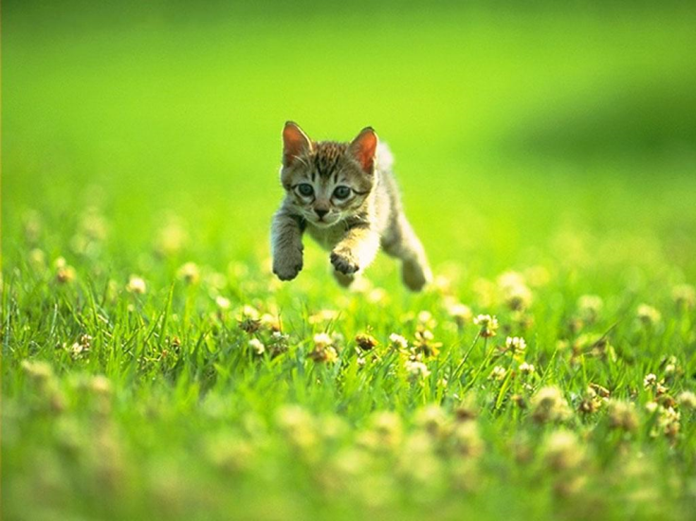
Animal Translator
A small, mobile speaker
A dog collar/ speaker
Press of a button
Antenna for wireless

Slide 3
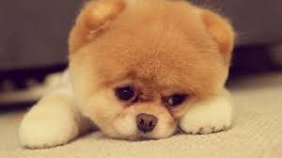
Purposes
Allows you to speak to animals.
Gives advantage of knowing pets needs.
Necessary for wanting to talk with pets.

Slide 4
Sizes
Speaker:
Not bigger than a cell phone.
Very easy to use
Easy to take anywhere you go
Collars: XS, Small, Medium, Large, XL
All pet translators are sold separately.

Slide 5
Invention Colors
Colors Include:
Black
White
Pink
Red
Blue

Slide 6
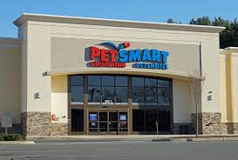
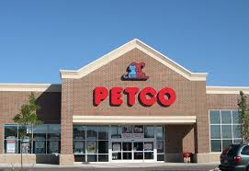
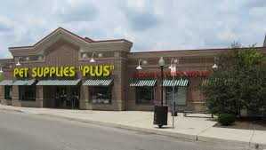
Stores Sold In:
Target
Pet Smart
Petco
Walmart
Best Buy
Pet Supplies

Slide 7
Reasoning
Costs: $149.99
High quality
Useful for pet owners
Worth the price

Slide 8
Warranty
The pet translator is a little pricey, but worth it!
Comes with a warranty.
Insures you get your moneys worth.
Breaks within year, will be replaced.
If unsatisfied full money back guaranteed.

Slide 9
Target and Time
Best product for all pet owners!
Commercials are shown in the evening.
6pm
This is the time most adults are home.
Children are out of school.
Have pets; thought was good invention.

