Slide 1
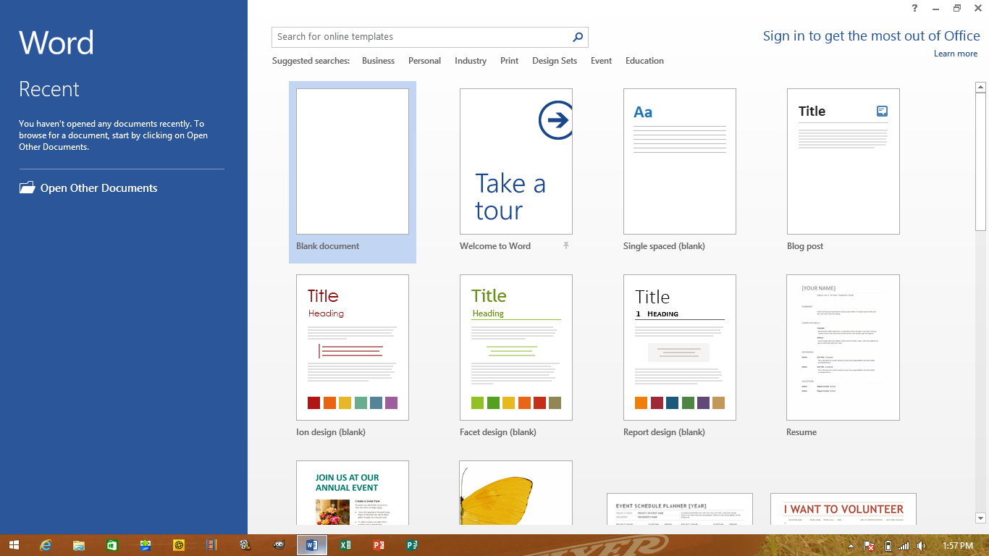
When you open Word 2013, you see the new screen below:
Choose “blank document”

Slide 2
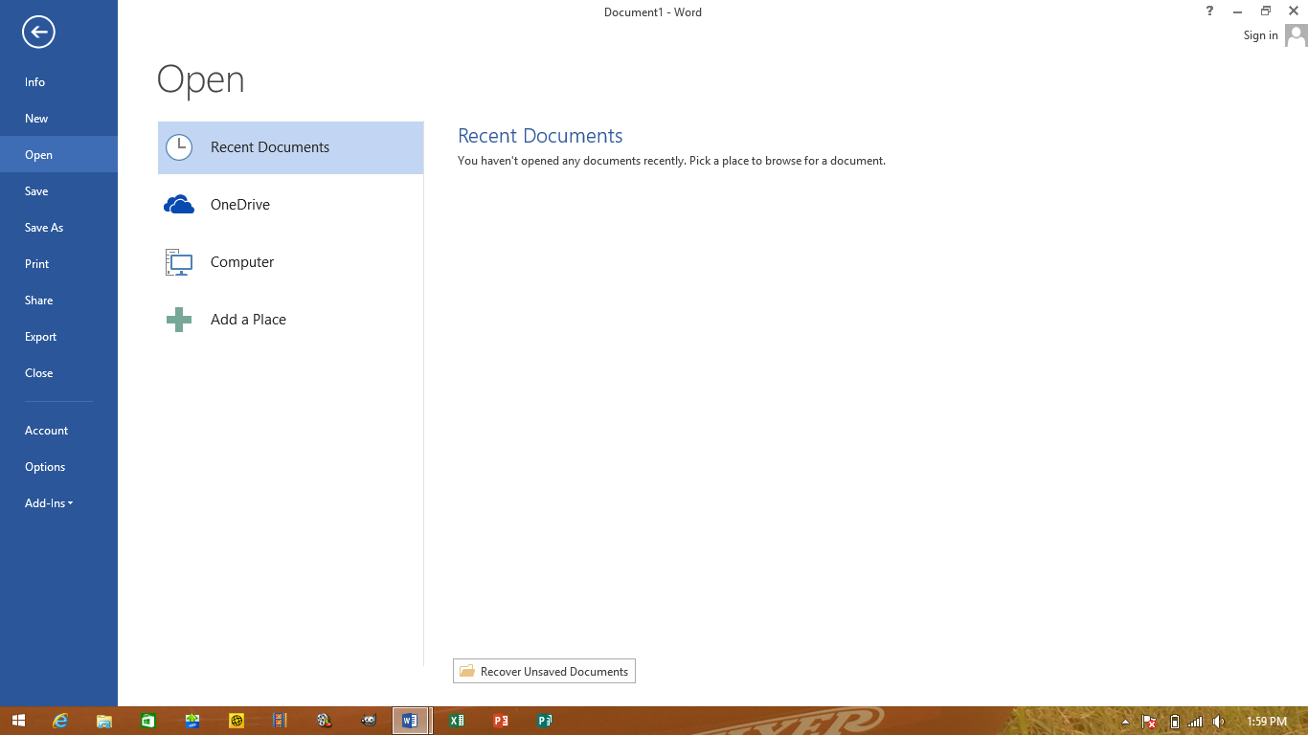
Quick Access Toolbar
Title Bar
1.
Tabs
Contextual Tab
2.
3.
4.
5.
Ribbon
Click here to go back to document
Groups
6.
Dialog Box Launcher
takes you to . . .
7.
Backstage View
Gallery
8.
9.
Scroll
Bar
10.
Mini Toolbar
11.
Zoom
Controls
12.
Status Bar
14.
13.
Task Bar

Slide 3
On the back of your Layout Notes sheet write down the answer to this question as it will appear on MULTIPLE tests and worksheets throughout the year!!
What is the relationship between the following terms: ribbon, tab, groups?
Click on a TAB
to open the RIBBON,
on the RIBBON there are GROUPS.

