Slide 1
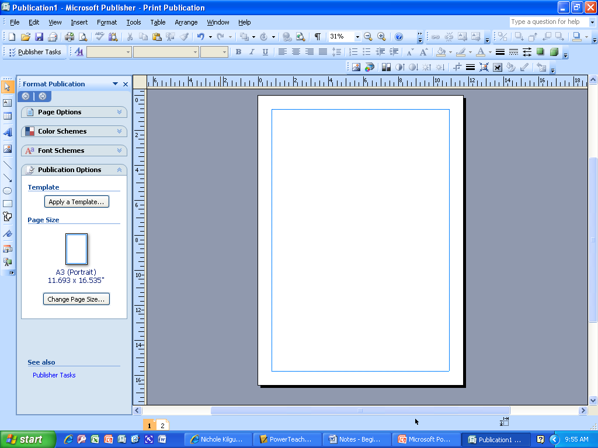
2. Other Task panes Arrow
4. Standard Toolbar
5. Formatting Toolbar
1. Format Publication Task Pane
3. Page Navigator

Slide 2
A predesigned file that you can use to create a new file
Template:
Gallery with predesigned graphics & text placeholders available to enhance your publication
Design Gallery:
Allows for quick movement from one page to another
Page Navigator:
Guides placed in templates showing various margins, grids, columns, rows, etc.
Layout Guides:

