Slide 1
Employment Laws

Slide 2
Unemployment Compensation
Insurance and compensation to workers who lose their jobs through a no-fault circumstance and must be available to work
You must be out of work through no fault of your own:
Laid off
Lose your job in a reduction-in-force
Downsized for economic reasons
“You must register for work with the Illinois Employment Service, either online or in person. You must keep a record of your job search efforts, including the dates and places you apply for work. When you apply for benefits, you will receive a form on which to record this information, which you may have to provide to the agency.”
Will receive income for up to 25 weeks in a one year period depending on how long you worked

Slide 3
“In Illinois, employees who are fired for theft or committing a felony will not qualify for unemployment benefits. If you are fired for other types of work-related misconduct, you also may not be eligible to collect benefits.
If you quit, you will remain eligible for unemployment if you had a good reason relating to your job, such as sexual harassment. If you left the job because of domestic violence, for health reasons, or to accompany a spouse in the military, you may still be eligible for benefits. And, if you quit your job to take another position (but that position fell through), you may still be eligible to collect unemployment.”

Slide 4
Fair Labor Standards Act
Established minimum wage and overtime pay
“Overtime wages” =
Federal Minimum Wage / IL Minimum Wage
$7.25 / hr $8.25 / hr
IL . . . $9.25 on 1/1/2020 and $10.00 on 7/1/2020
Under 18 IL Min. Wage
$7.75/ hr For 1st 90 days
Tipped Employees
$4.65/ hr for 1st 90 days
$4.95/hr after 90 days
1 ½ time the hourly rate for hours over 40

Slide 5
1938 =
Lowest =
Highest =
$.25
$7.25 (federal) in several states
$12 – California (more than 26 employees, otherwise $11)
$12.00 = Washington
$12.00 = Massachusetts
$14 on July 1st = Wash. DC

Slide 6
Family and Medical Leave Act
Allowed up to 12 weeks of unpaid leave in a 12-month period for certain medical and family situations
Birth and Care of newborn, including adoption
Care of immediate family member (child, spouse, parent) with serious illness
Unable to work due to serious health condition
Allowed 26 weeks in a 12 mon. period for a covered service member (spouse, child, parent, caregiver) with serious injury/illness

Slide 7
Worker’s Compensation
Benefits to workers and families for injury, illness, or death as a result of their job
Equal Pay Act
Prohibits unequal pay for men and women doing the same work for the same amount of time (and have same qualifications)

Slide 8
Civil Rights Act
Prohibits discrimination in employment due to race, color, gender, religion, national origin, etc.
Age Discrimination in Employment Act
“Protects certain applicants/employees 40+ from discrimination on the basis of age in hiring, promotion, discharge, compensation, or terms, conditions or privileges of employment”
https://www.dol.gov/general/topic/discrimination/agedisc

Slide 9
Americans with Disabilities Act
“Prohibits discrimination against individuals with disabilities in all areas of public life, including jobs, schools, transportation, and all public/private areas that are open to the general public”
https://adata.org/learn-about-ada

Slide 10
TAXES

Slide 11
W-4 Form
Used to determine the amount of income tax withheld from paychecks
“Dependents”
Someone who lives with you
Provide for over 50% of their living expenses
Claim “Allowances” on the W-4
Each allowance claimed will reduce the amount of taxes withheld from each paycheck
A dependent is claimed as an allowance
The more allowances you claim = less $ withheld
The less allowances you claim = more $ withheld

Slide 12
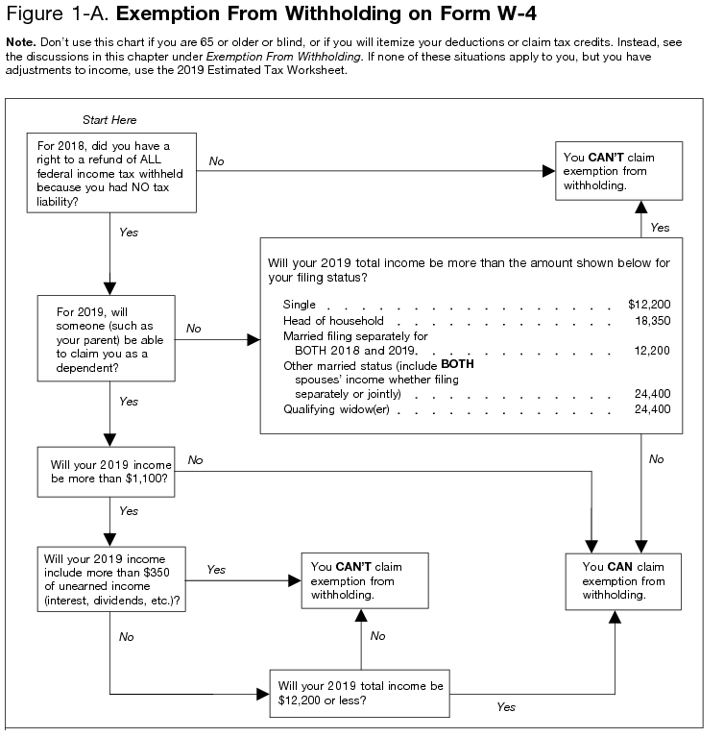
Exempt Status
Did not earn enough money in a year to owe Federal Income Taxes
Single, Dependent = $12,200
If unsure, file anyway to
get a possible refund

Slide 13
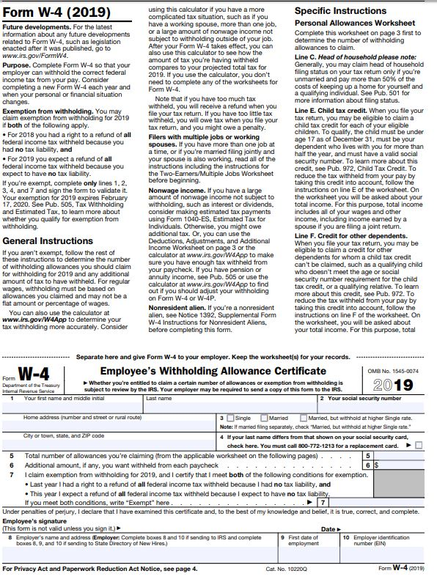
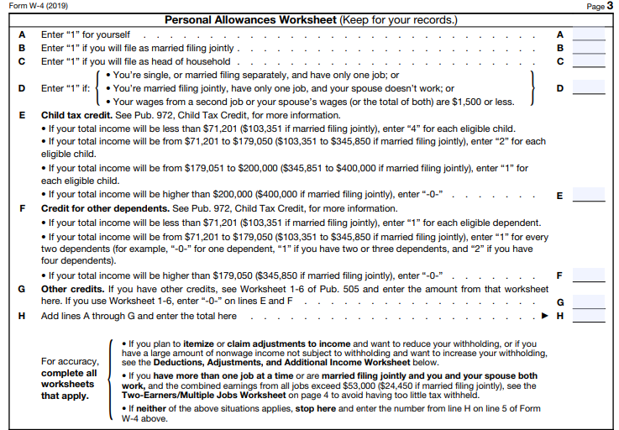
W-4 Form

Slide 14
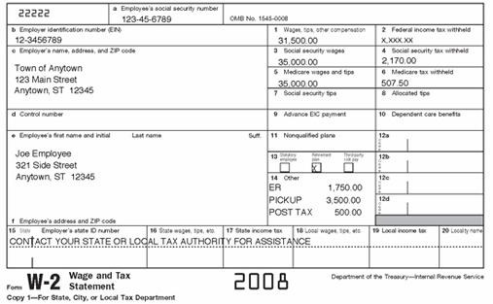
Form W-2

Slide 15
Purpose of a Form W-2
A summary of TWO THINGS!
1. Your income over the last year
2. Taxes withheld throughout the year
Receive no later than January 31
Needed in order to file tax returns

Slide 16
When do taxes need to be filed by?
April 15th (a Wed this year)
If the 15th falls on a weekend:
Due next work day

Slide 17
Taxes Taken out of every Paycheck
Federal Income Tax
Social Security (FICA)
Medicare
State Income Tax
Take Home Pay:
Amount leftover after all tax deductions

Slide 18
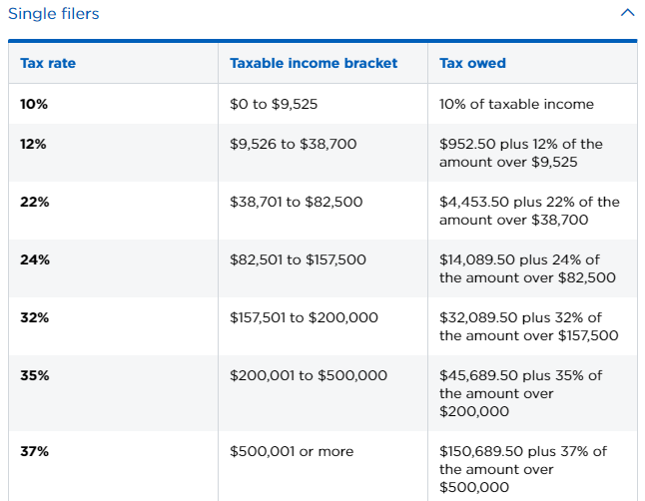
Federal Income Tax
16th Amendment – tax on income
“Pay as you go” method
Depends on what you put on W-4 AND Tax Bracket (7 brackets)
CAN be Exempt from paying

Slide 19
Social Security Act - (1935)
Provides federal aid for the elderly and disabled workers (MANDATORY)
YOUR SS Tax Rate = 6.2%
Your Employer also pays into it: 6.2%
Social Security Act later called:
FICA: Federal Insurance Contribution Act
Added: Medicare (health insurance program for elderly) & Medicaid (health insurance program for the poor)

Slide 20
Medicare
Hospital and Medical Insurance for the elderly
Medicare Tax Rate = 2.9%
Employee payroll deductions 1.45%
Employer matches at 1.45%
What happened to the elderly before 1935??

Slide 21
State Income Tax
Tax on personal income
in most states but not all
In place or in addition to a sales tax
Illinois
Tax rate = 4.95%
Uses of the money?

Slide 22
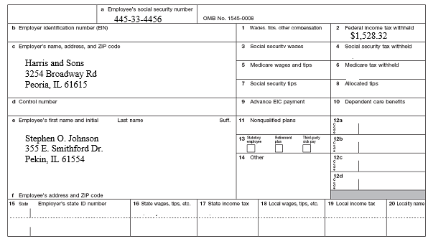
Calculating Payroll Deductions
Income for the Year = $17,985.00
Social Security (6.2%): State (4.95%):
Medicare (1.45%):
17,985 x 6.2% =
17,985 x .062 =
17,985 x 4.95% =
17,985 x .0495 =
$1,115.07
$890.26
17,985 x 1.45% =
17,985 x .0145 =
$260.78

Slide 23
Other Deductions from Paychecks
Group Health / Life / Dental Insurance
Retirement or Pension Plans
Credit Unions/ Automatic Savings
Union / Association Dues
Charities

